Slide 1
Image Enhancement in Frequency Domain
Imran Siddiqi
imran.siddiqi@mcs.edu.pk
Computer Science Department
College of Telecommunication Engineering
National University of Sciences and Technology

Slide 2
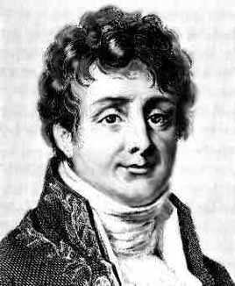
Joseph Fourier (1768 – 1830)
  Most famous for his work “La Théorie Analitique de la Chaleur” published in 1822
  Translated into English in 1878: “The Analytic Theory of Heat”
Nobody paid much attention when the work was first published
One of the most important mathematical theories in modern engineering

Slide 3
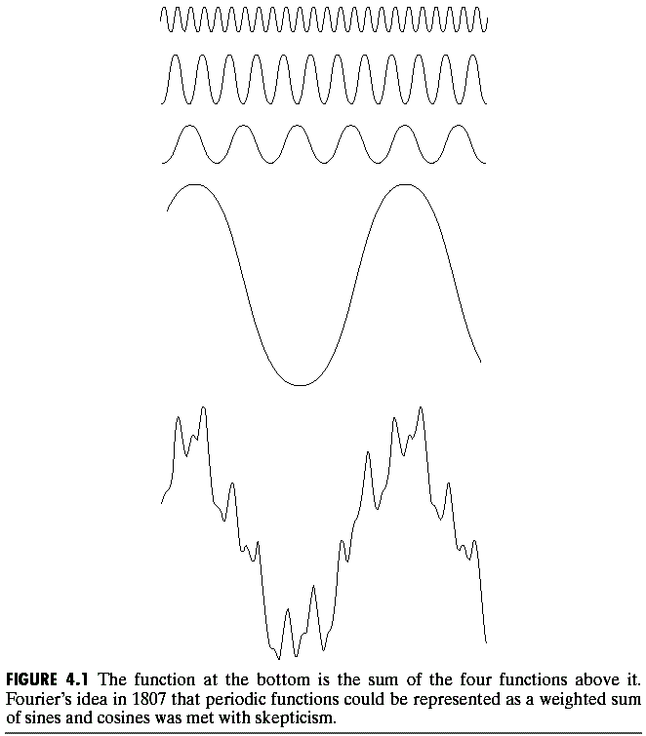
The big idea …
Any function that periodically repeats itself can be expressed as a sum of sines and cosines of different frequencies each multiplied by a different coefficient – a Fourier series
=

Slide 4
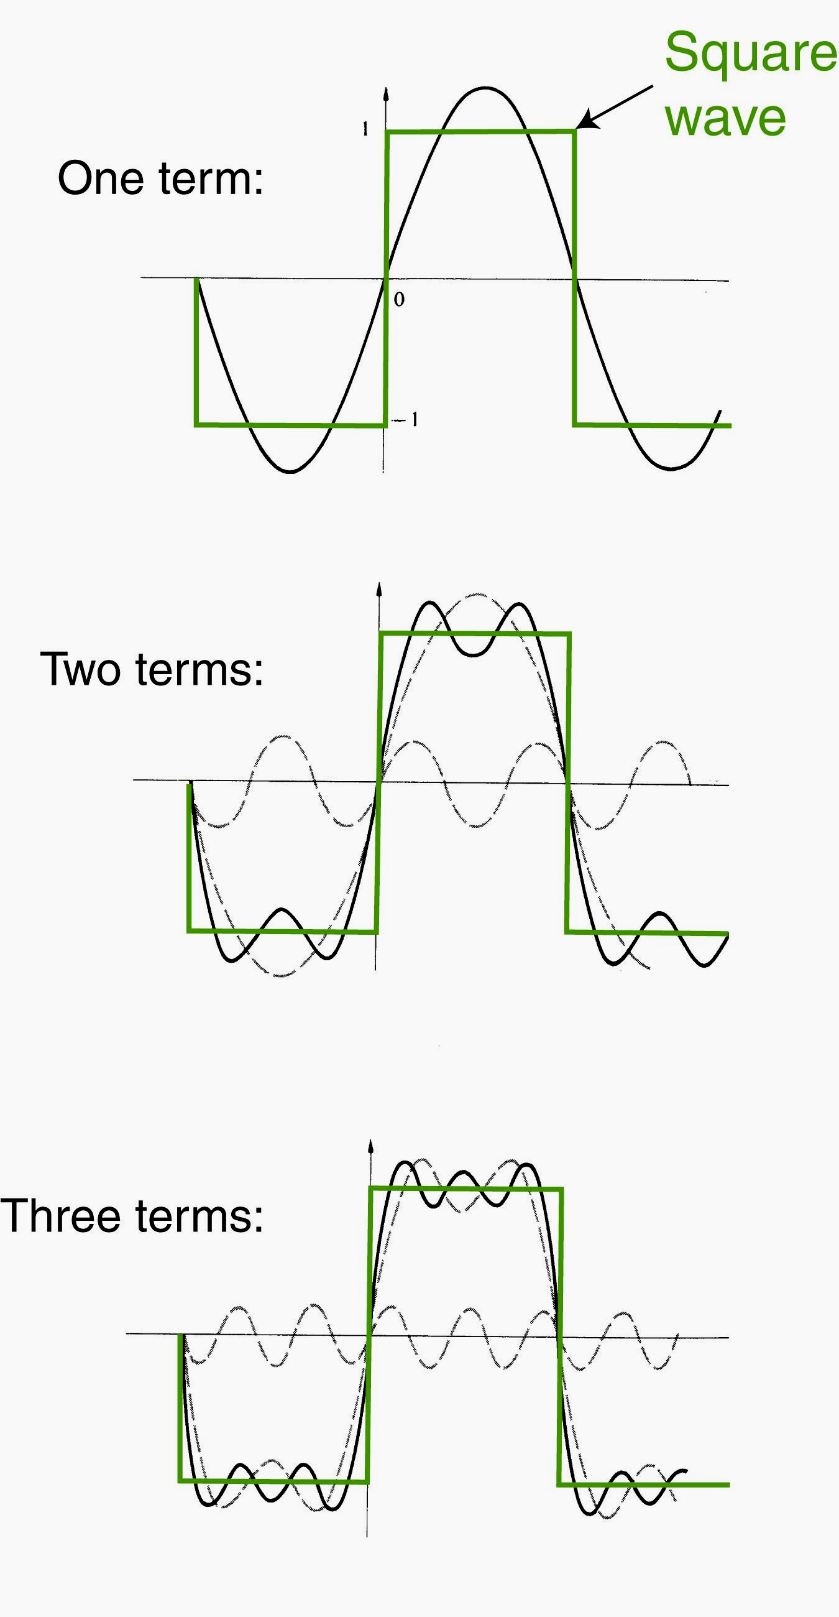
The big idea…
Approximating a square wave as the sum of sine waves

Slide 5
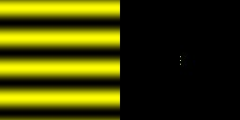
Frequencies in Images

Slide 6
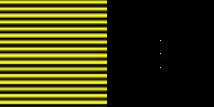
Frequencies in Images

Slide 7
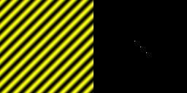
Frequencies in Images

Slide 8
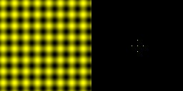
Frequencies in Images

Slide 9
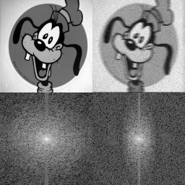
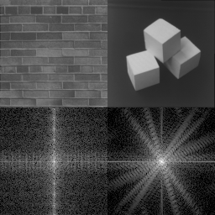
Frequencies in Images

Slide 10
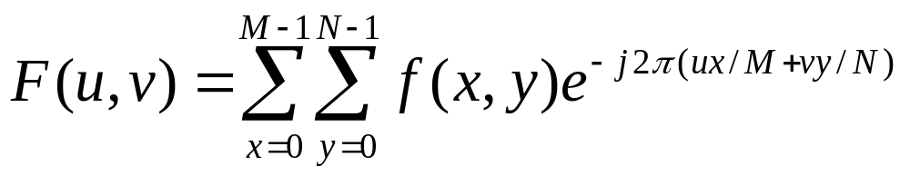
The Discrete Fourier Transform (DFT)
The Discrete Fourier Transform of f(x, y), for x = 0, 1, 2…M-1 and y = 0,1,2…N-1, denoted by F(u, v), is given by the equation:
for u = 0, 1, 2…M-1 and v = 0, 1, 2…N-1.

Slide 11
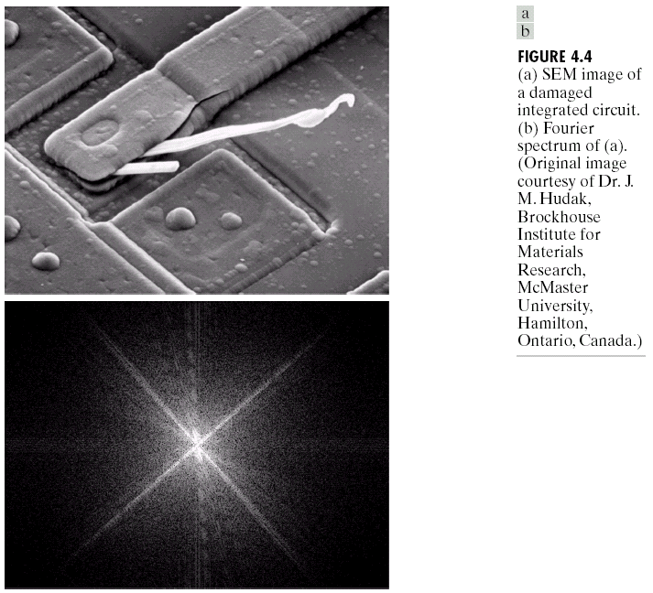
DFT & Images
DFT
Scanning electron microscope image of an integrated circuit magnified ~2500 times
Fourier spectrum of the image

Slide 14
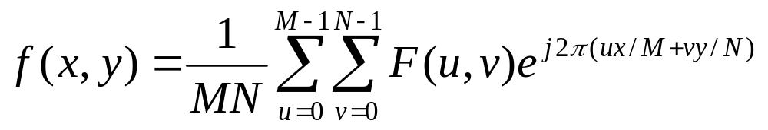
The Inverse DFT
It is really important to note that the Fourier transform is completely reversible
The inverse DFT is given by:
for x = 0, 1, 2…M-1 and y = 0, 1, 2…N-1

Slide 15
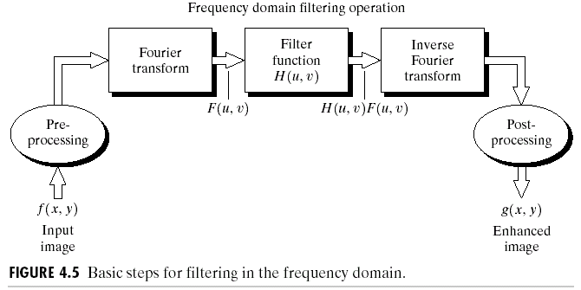
The DFT and Image Processing
To filter an image in the frequency domain:
  Compute F(u,v) the DFT of the image
  Multiply F(u,v) by a filter function H(u,v)
  Compute the inverse DFT of the result

Slide 16
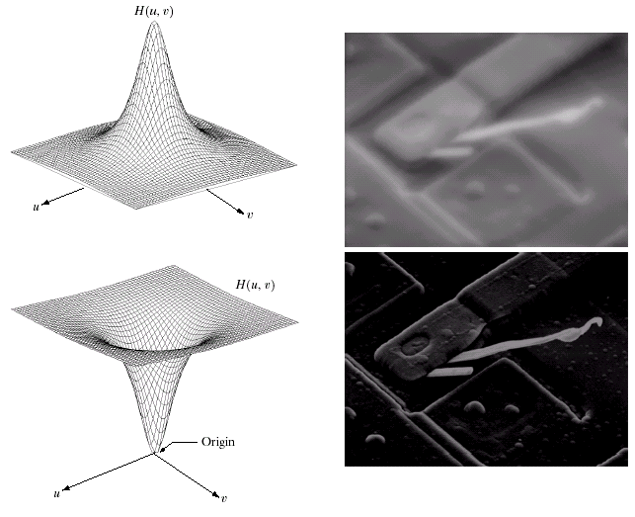
Some Basic Frequency Domain Filters
Low Pass Filter
High Pass Filter

Slide 17
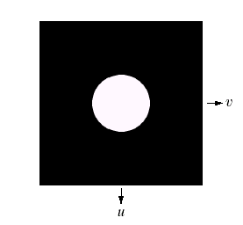
Ideal Low Pass Filter
Simply cut off all high frequency components that are a specified distance D₀ from the origin

Slide 18
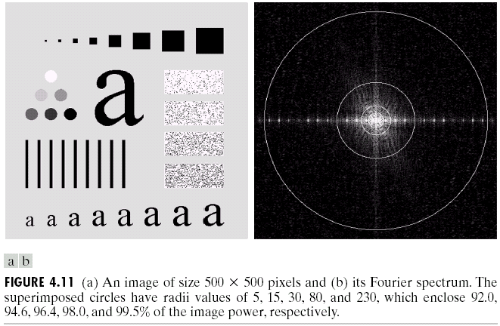
Ideal Low Pass Filter (cont…)
Above we show an image, it’s Fourier spectrum and a series of ideal low pass filters of radius 5, 15, 30, 80 and 230 superimposed on top of it

Slide 19
Ideal Low Pass Filter (cont…)

Slide 20
Ideal Low Pass Filter (cont…)

Slide 21
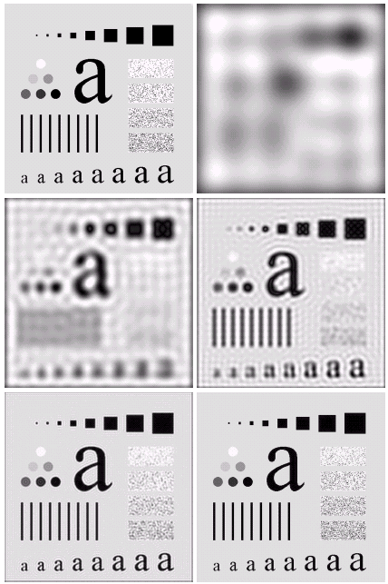
Result of filtering with ideal low pass filter of radius 5
Original
image
Result of filtering with ideal low pass filter of radius 15
Result of filtering with ideal low pass filter of radius 30
Result of filtering with ideal low pass filter of radius 80
Result of filtering with ideal low pass filter of radius 230

Slide 22
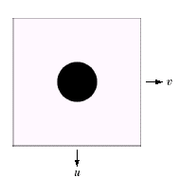
Ideal High Pass Filters
The ideal high pass filter is given as:

Slide 23
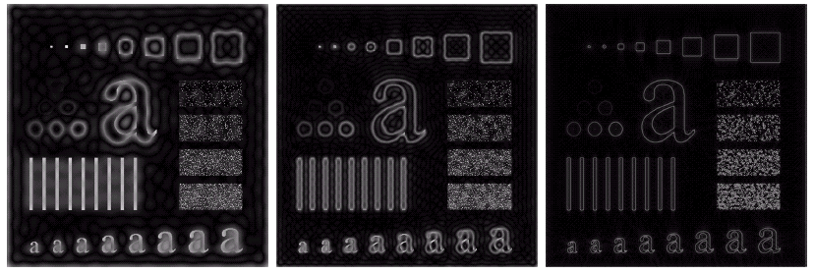
Results of ideal high pass filtering with D₀ = 15
Results of ideal high pass filtering with D₀ = 30
Results of ideal high pass filtering with D₀ = 80

